Slide 1
Robert Morris, M. Frans Kaashoek, David Karger, Hari Balakrishnan, Ion Stoica, David Liben-Nowell, Frank Dabek
Chord:
A scalable peer-to-peer look-up protocol for internet applications
Acknowledgement
Taken slides from University of California, berkely and Max planck institute

Slide 2
Overview
Introduction
The Chord Algorithm
  Construction of the Chord ring
  Localization of nodes
  Node joins and stabilization
  Failure of nodes
Applications
Summary
Questions

Slide 3
The lookup problem
N₂
N₁
N₃
Key=“title”
Value=MP3 data…
Internet
Publisher
N₄
N₆
N₅
?
Client
Lookup(“title”)
Notes:
1000s of nodes.
Set of nodes may change…

Slide 4
What is Chord?
In short: a peer-to-peer lookup service
Solves problem of locating a data item in a collection of distributed nodes, considering frequent node arrivals and departures
Core operation in most p2p systems is efficient location of data items
Supports just one operation: given a key, it maps the key onto a node

Slide 5
Chord characteristics
Simplicity, provable correctness, and provable performance
Each Chord node needs routing information about only a few other nodes
Resolves lookups via messages to other nodes (iteratively or recursively)
Maintains routing information as nodes join and leave the system

Slide 6
Addressed Difficult Problems (1)
Load balance: distributed hash function, spreading keys evenly over nodes
Decentralization: chord is fully distributed, no node more important than other, improves robustness
Scalability: logarithmic growth of lookup costs with number of nodes in network, even very large systems are feasible

Slide 7
Addressed Difficult Problems (2)
Availability: chord automatically adjusts its internal tables to ensure that the node responsible for a key can always be found
Flexible naming: no constraints on the structure of the keys – key-space is flat, flexibility in how to map names to Chord keys

Slide 8
Overview
Introduction
The Chord Algorithm
  Construction of the Chord ring
  Localization of nodes
  Node joins and Stabilization
  Failure/Departure of nodes
Applications
Summary
Questions

Slide 9
The Base Chord Protocol
Specifies how to find the locations of keys
How new nodes join the system
How to recover from the failure or planned departure of existing nodes

Slide 10
The Chord algorithm –
Construction of the Chord ring
Hash function assigns each node and key an m-bit identifier using a base hash function such as SHA-1
  ID(node) = hash(IP, Port)
  ID(key) = hash(key)
  Both are uniformly distributed
  Both exist in the same ID space
Properties of consistent hashing:
  Function balances load: all nodes receive roughly the same number of keys – good?
  When an Nth node joins (or leaves) the network, only an O(1/N) fraction of the keys are moved to a different location

Slide 11
The Chord algorithm –
Construction of the Chord ring
identifiers are arranged on a identifier circle modulo 2 => Chord ring
a key k is assigned to the node whose identifier is equal to or greater than the key‘s identifier
this node is called successor(k) and is the first node clockwise from k.
m

Slide 12
The Chord algorithm –
Construction of the Chord ring
identifier
node
6
X
key
1
0
successor(1) = 1
7
1
identifier
circle
successor(6) = 0
6
6
2
2
successor(2) = 3
5
3
4
2

Slide 13
Node Joins and Departures
6
6
1
successor(6) = 7
0
7
1
successor(1) = 3
6
2
5
3
4
2
1

Slide 14
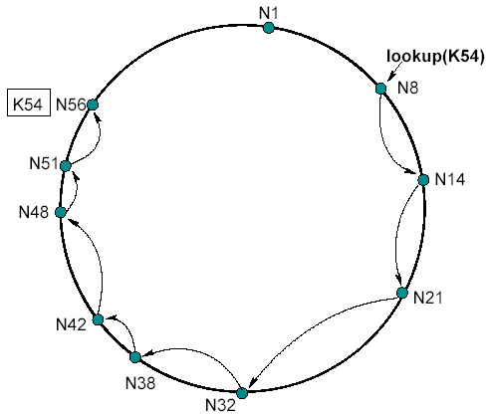
The Chord algorithm –
Simple node localization
// ask node n to find the successor of id
n.find_successor(id)
if (id (n; successor])
return successor;
else
// forward the query around the
circle
return successor.find_successor(id);
=> Number of messages linear in the number of nodes !

Slide 15
The Chord algorithm –
Scalable node localization
Additional routing information to accelerate lookups
Each node n contains a routing table with up to m entries (m: number of bits of the identifiers) => finger table
i entry in the table at node n contains the first node s that succeds n by at least 2
s = successor (n + 2 )
s is called the i finger of node n
th
i-1
i-1
th

Slide 16
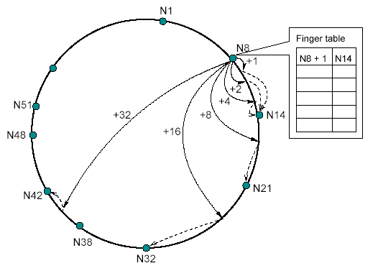
The Chord algorithm –
Scalable node localization
Finger table:
finger[i] =
successor (n + 2 )
i-1

Slide 17
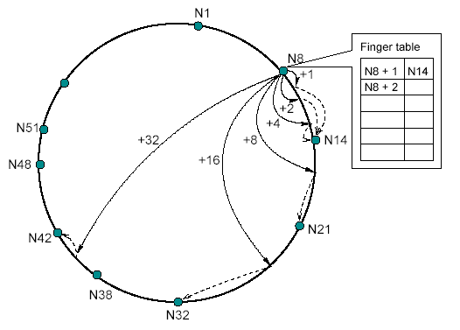
The Chord algorithm –
Scalable node localization
Finger table:
finger[i] =
successor (n + 2 )
i-1

Slide 18
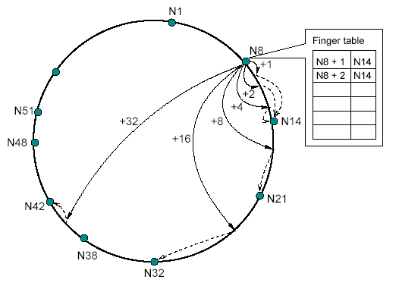
The Chord algorithm –
Scalable node localization
Finger table:
finger[i] =
successor (n + 2 )
i-1

Slide 19
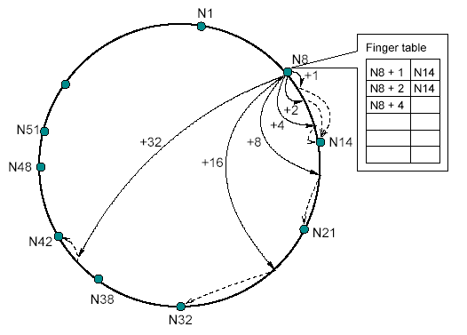
The Chord algorithm –
Scalable node localization
Finger table:
finger[i] =
successor (n + 2 )
i-1

Slide 20
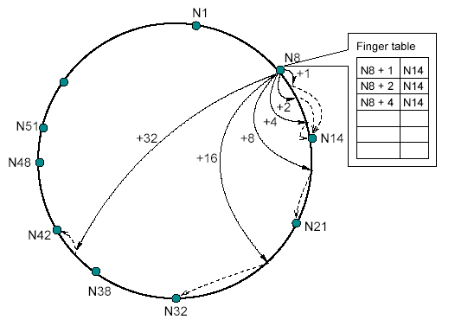
The Chord algorithm –
Scalable node localization
Finger table:
finger[i] =
successor (n + 2 )
i-1

Slide 21
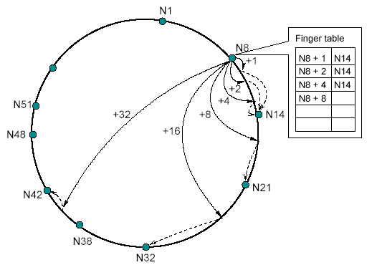
The Chord algorithm –
Scalable node localization
Finger table:
finger[i] =
successor (n + 2 )
i-1

Slide 22
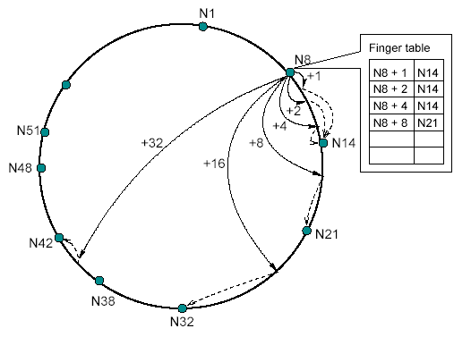
The Chord algorithm –
Scalable node localization
Finger table:
finger[i] =
successor (n + 2 )
i-1

Slide 23
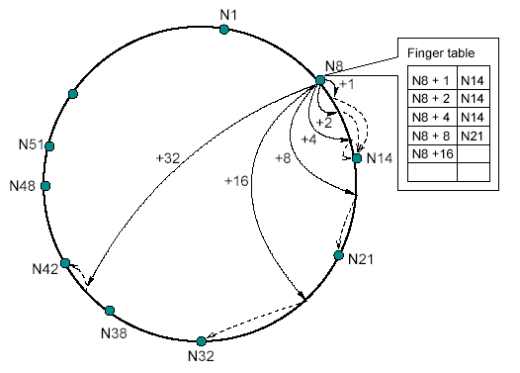
The Chord algorithm –
Scalable node localization
Finger table:
finger[i] =
successor (n + 2 )
i-1

Slide 24
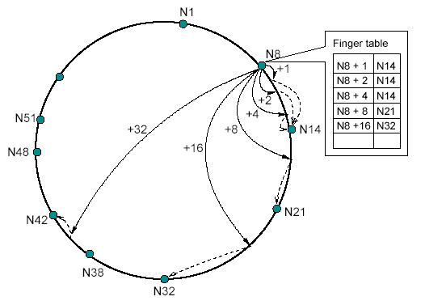
The Chord algorithm –
Scalable node localization
Finger table:
finger[i] =
successor (n + 2 )
i-1

Slide 25
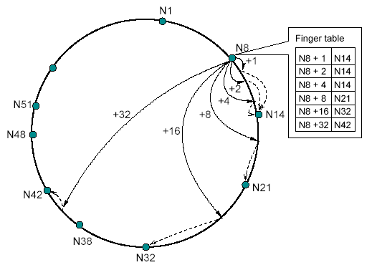
The Chord algorithm –
Scalable node localization
Finger table:
finger[i] =
successor (n + 2 )
i-1

Slide 26
The Chord algorithm –
Scalable node localization
Important characteristics of this scheme:
Each node stores information about only a small number of nodes (m)
Each nodes knows more about nodes closely following it than about nodes farer away
A finger table generally does not contain enough information to directly determine the successor of an arbitrary key k

Slide 27
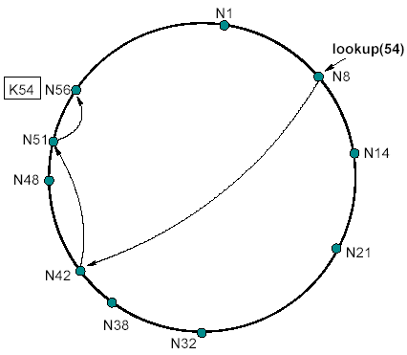
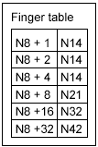
The Chord algorithm –
Scalable node localization
Search in finger table for the nodes which most immediatly precedes id
Invoke find_successor from that node
=> Number of messages O(log N)!

Slide 28
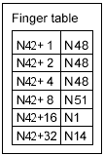
The Chord algorithm –
Scalable node localization
Search in finger table for the nodes which most immediatly precedes id
Invoke find_successor from that node
=> Number of messages O(log N)!

Slide 29
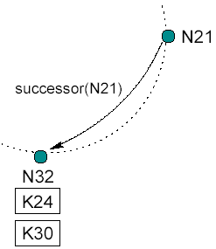
The Chord algorithm –
Node joins and stabilization

Slide 30
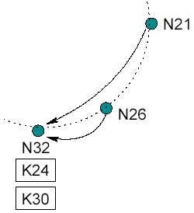
The Chord algorithm –
Node joins and stabilization

Slide 31
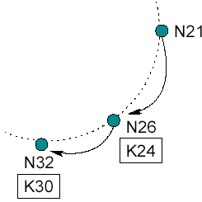
The Chord algorithm –
Node joins and stabilization

Slide 32
The Chord algorithm –
Node joins and stabilization
To ensure correct lookups, all successor pointers must be up to date
=> stabilization protocol running periodically in the background
Updates finger tables and successor pointers

Slide 33
The Chord algorithm –
Node joins and stabilization
Stabilization protocol:
Stabilize(): n asks its successor for its predecessor p and decides whether p should be n‘s successor instead (this is the case if p recently joined the system).
Notify(): notifies n‘s successor of its existence, so it can change its predecessor to n
Fix_fingers(): updates finger tables

Slide 34
The Chord algorithm –
Node joins and stabilization

Slide 35
The Chord algorithm –
Node joins and stabilization
N26 joins the system
N26 aquires N32 as its successor
N26 notifies N32
N32 aquires N26 as its predecessor

Slide 36
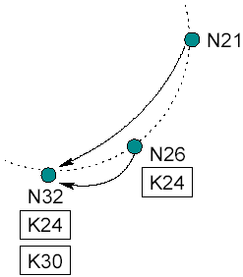
The Chord algorithm –
Node joins and stabilization
N26 copies keys
N21 runs stabilize() and asks its successor N32 for its predecessor which is N26.

Slide 37
The Chord algorithm –
Node joins and stabilization
N21 aquires N26 as its successor
N21 notifies N26 of its existence
N26 aquires N21 as predecessor

Slide 38
Node Joins – with Finger Tables
finger table
keys
start
int.
succ.
6
1
2
4
[1,2)
[2,4)
[4,0)
1
3
0
6
0
finger table
keys
start
int.
succ.
1
7
1
2
3
5
[2,3)
[3,5)
[5,1)
3
3
0
6
finger table
keys
start
int.
succ.
6
2
7
0
2
[7,0)
[0,2)
[2,6)
0
0
3
finger table
keys
5
3
start
int.
succ.
2
4
5
7
[4,5)
[5,7)
[7,3)
0
0
0
4
6
6

Slide 39
Node Departures – with Finger Tables
finger table
keys
start
int.
succ.
1
2
4
[1,2)
[2,4)
[4,0)
1
3
0
3
6
0
finger table
keys
start
int.
succ.
1
7
1
2
3
5
[2,3)
[3,5)
[5,1)
3
3
0
6
finger table
keys
start
int.
succ.
6
6
2
7
0
2
[7,0)
[0,2)
[2,6)
0
0
3
finger table
keys
5
3
start
int.
succ.
2
4
4
5
7
[4,5)
[5,7)
[7,3)
6
6
0
0

Slide 40
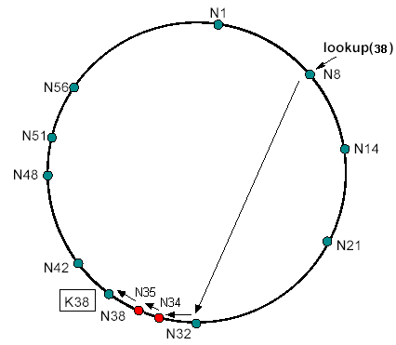
The Chord algorithm –
Impact of node joins on lookups
All finger table entries are correct => O(log N) lookups
Successor pointers correct, but fingers inaccurate => correct but slower lookups

Slide 41
The Chord algorithm –
Impact of node joins on lookups
Incorrect successor pointers => lookup might fail, retry after a pause
But still correctness!

Slide 42
The Chord algorithm –
Impact of node joins on lookups
Stabilization completed => no influence on performence
Only for the negligible case that a large number of nodes joins between the target‘s predecessor and the target, the lookup is slightly slower
No influence on performance as long as fingers are adjusted faster than the network doubles in size

Slide 43
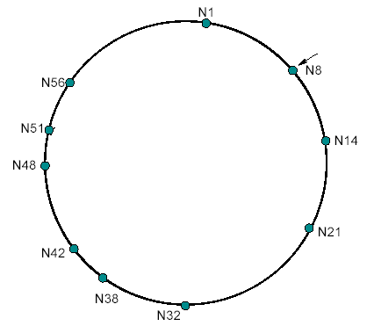
The Chord algorithm –
Failure of nodes
Correctness relies on correct successor pointers
What happens, if N14, N21, N32 fail simultaneously?
How can N8 aquire N38 as successor?

Slide 44
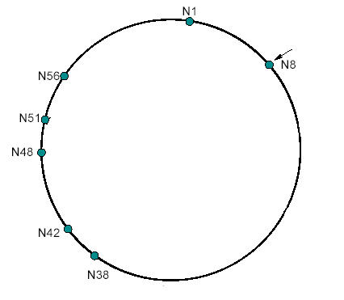
The Chord algorithm –
Failure of nodes
Correctness relies on correct successor pointers
What happens, if N14, N21, N32 fail simultaneously?
How can N8 aquire N38 as successor?

Slide 45
The Chord algorithm –
Failure of nodes
Each node maintains a successor list of size r
If the network is initially stable, and every node fails with probability ½, find_successor still finds the closest living successor to the query key and the expected time to execute find_succesor is O(log N)

Slide 46
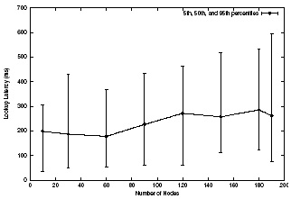
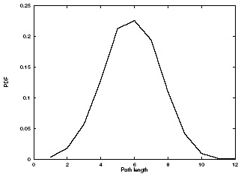
Experimental Results
Latency grows slowly with the total number of nodes
Path length for lookups is about ½ log₂N
Chord is robust in the face of multiple node failures

Slide 47
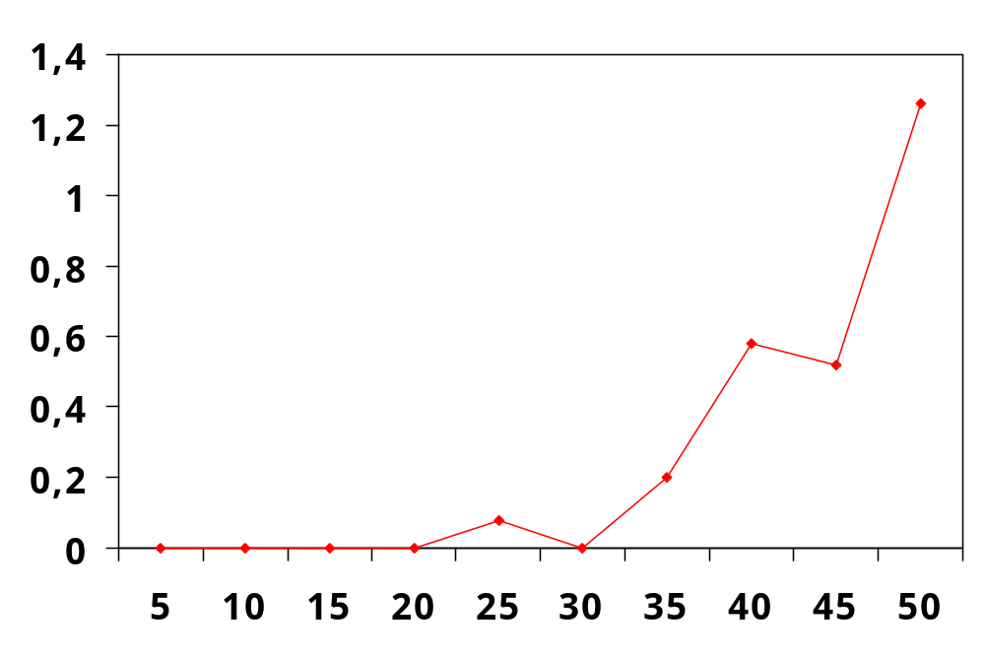
The Chord algorithm –
Failure of nodes
Massive failures have little impact
(1/2)⁶ is 1.6%
Failed Lookups (Percent)
Failed Nodes (Percent)
Notes:
*before* stabilization starts.
All lookup failures attributable to loss of all 6 replicas.

Slide 48
Overview
Introduction
The Chord Algorithm
  Construction of the Chord ring
  Localization of nodes
  Node joins and stabilization
  Failure/Departure of nodes
Applications
Summary
Questions

Slide 49
Applications:
Time-shared storage
for nodes with intermittent connectivity (server only occasionally available)
Store others‘ data while connected, in return having their data stored while disconnected
Data‘s name can be used to identify the live Chord node (content-based routing)

Slide 50
Applications:
Chord-based DNS
DNS provides a lookup service
keys: host names values: IP adresses
Chord could hash each host name to a key
Chord-based DNS:
  no special root servers
  no manual management of routing information
  no naming structure
  can find objects not tied to particular machines

Slide 51
Summary
Simple, powerful protocol
Only operation: map a key to the responsible node
Each node maintains information about O(log N) other nodes
Lookups via O(log N) messages
Scales well with number of nodes
Continues to function correctly despite even major changes of the system

